Slide 1
The Protein Chip - Design Review -
8/10/2015
ACBS Group meeting
Sung Sik Woo

Slide 2
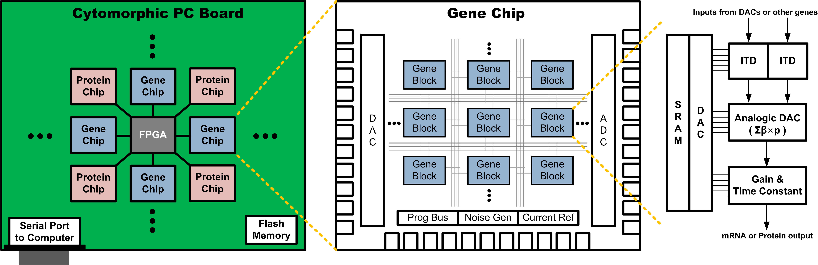
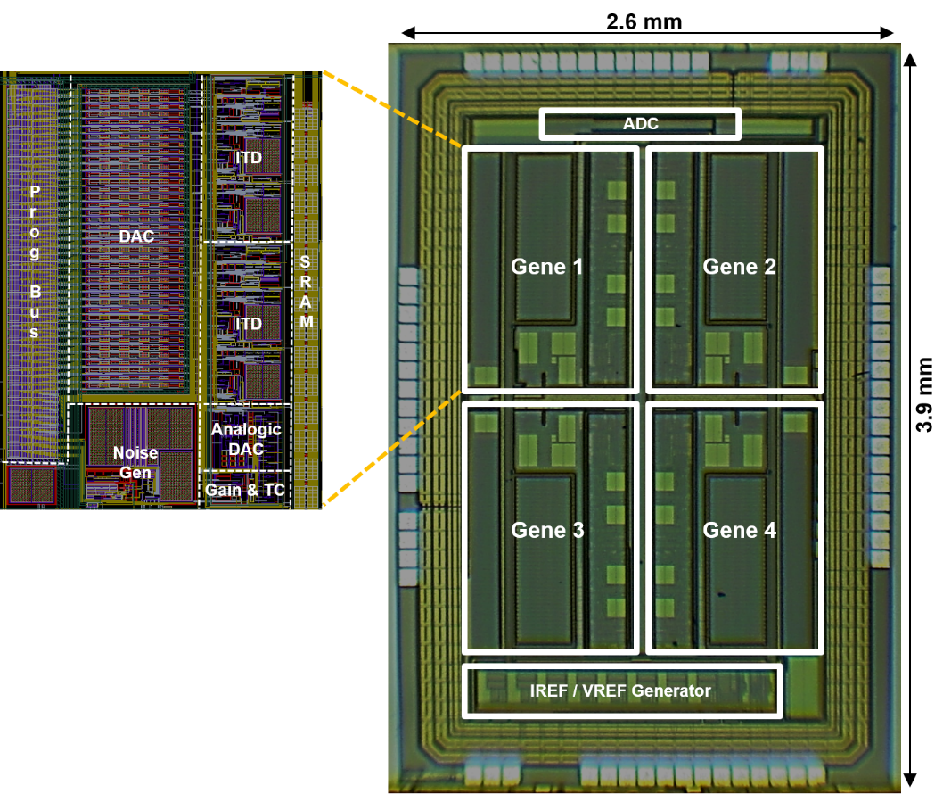
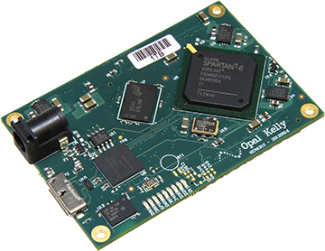

Slide 3
Common Types of Reactions
Association
Dissociation
Cascade
Degradation
Fan-out
Fan-in

Slide 4
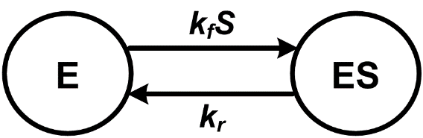
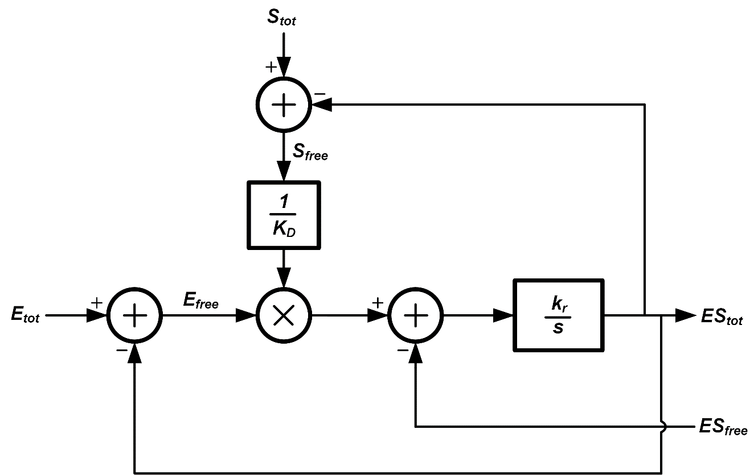
MM Block

Slide 5
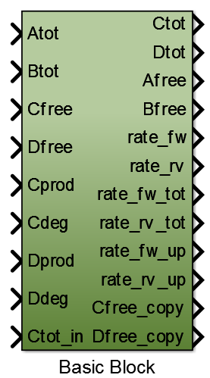
Modified Basic Block
0th, 1st, 2nd order reactions
Association, dissociation, replacement reactions

Slide 6
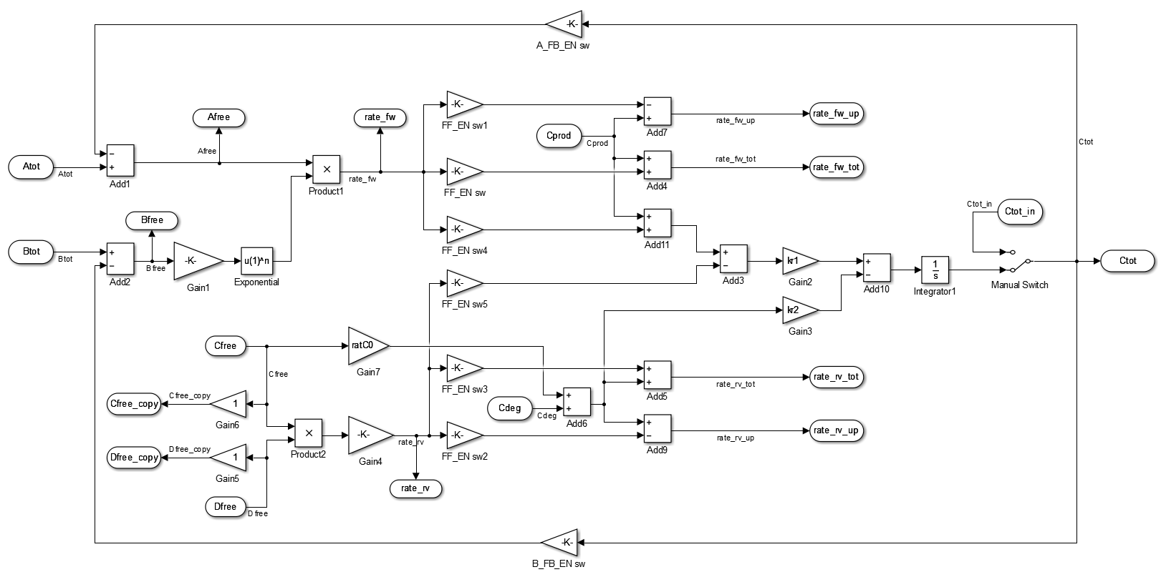
Simulink Model

Slide 7
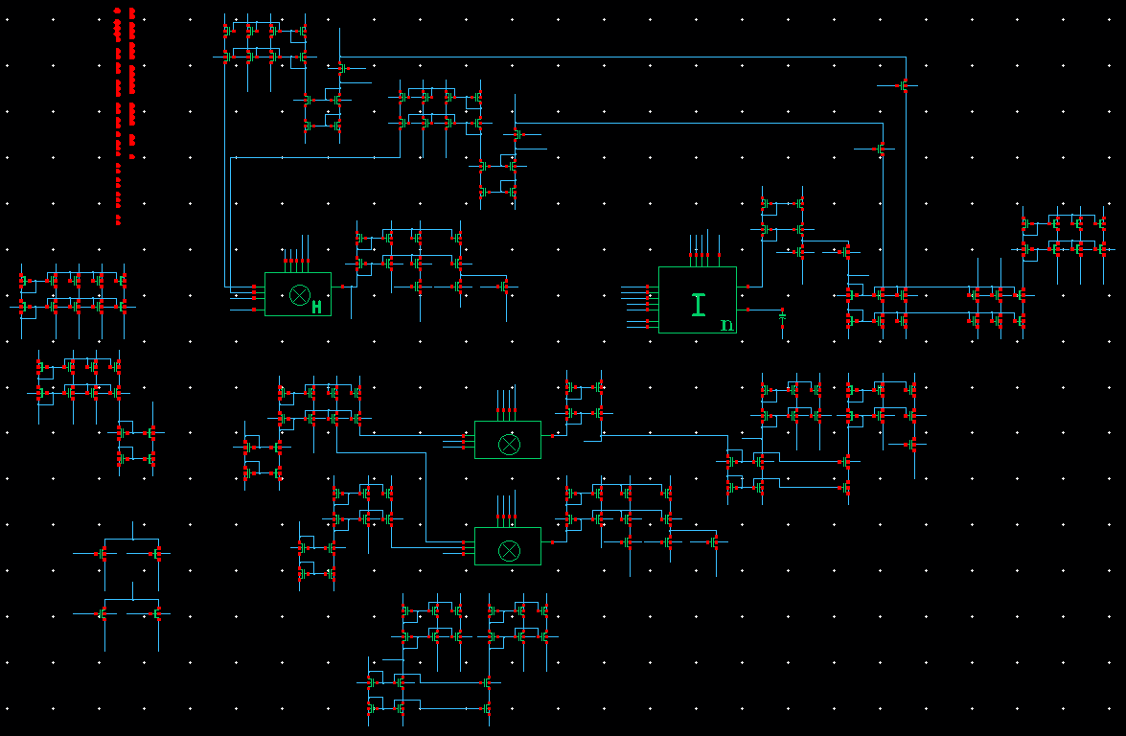
Cadence Model

Slide 8
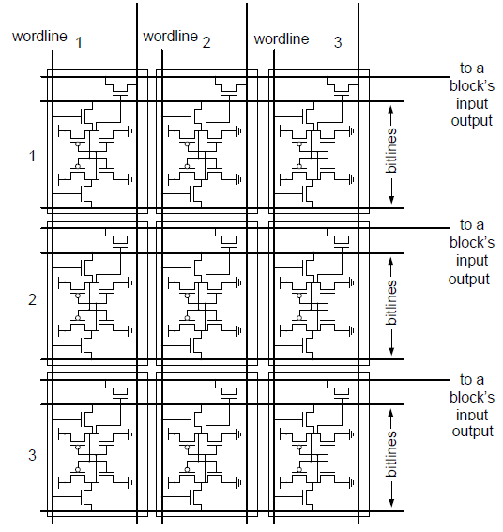

Slide 9
Connection SRAM

Slide 10
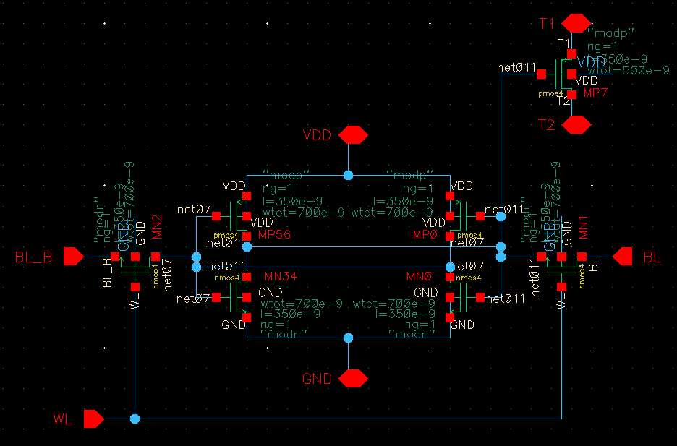
Connection SRAM

Slide 11
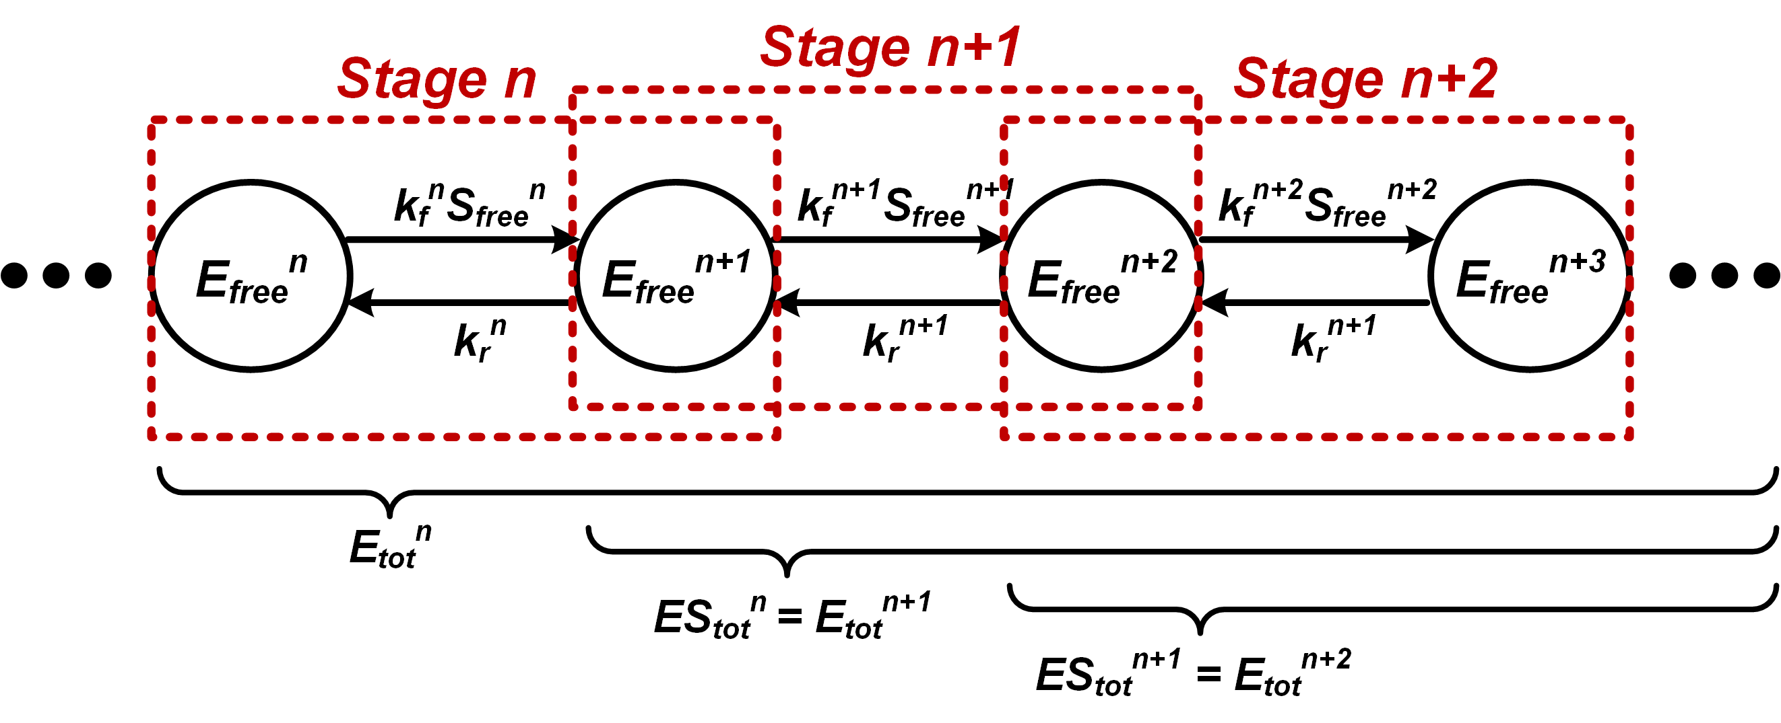
Cascade Reaction

Slide 12
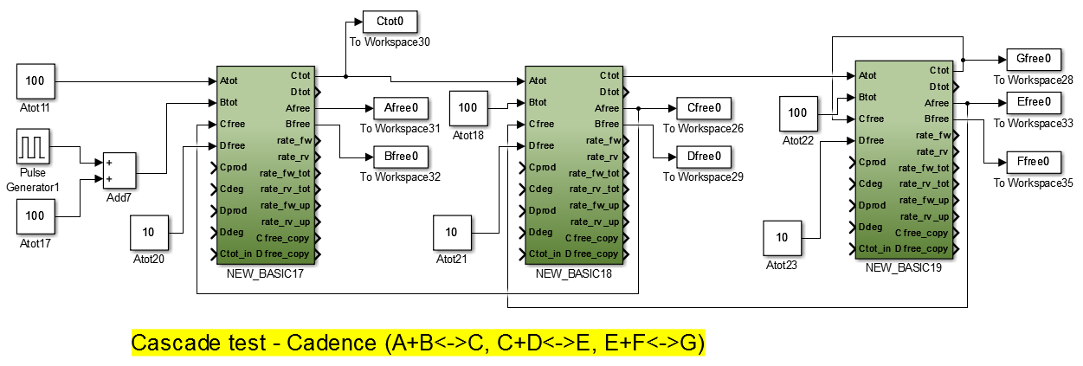
Cascade Reaction

Slide 13
Degradation Reaction
Subtract ΥE_{free} from all upstream total vars
Receive, add, and send

Slide 14
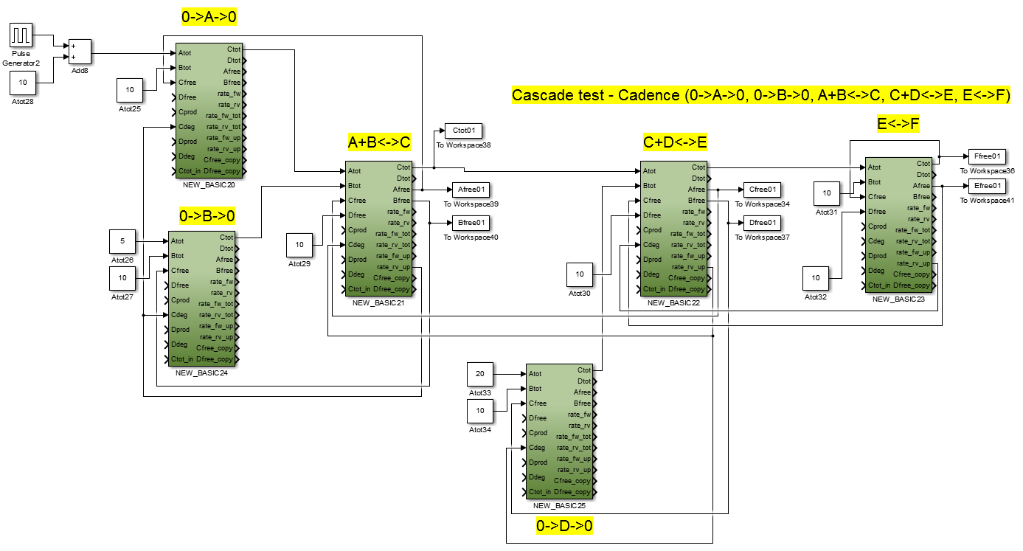
Cascade w/ degradation

Slide 15
Fanout Reaction

Slide 16
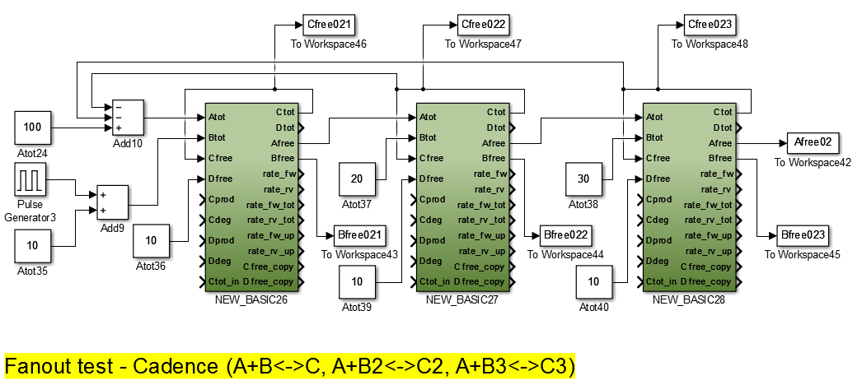
Fanout Reaction

Slide 17
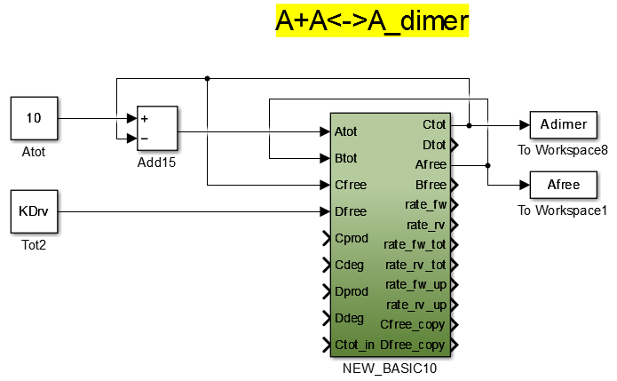
Dimerization

Slide 18
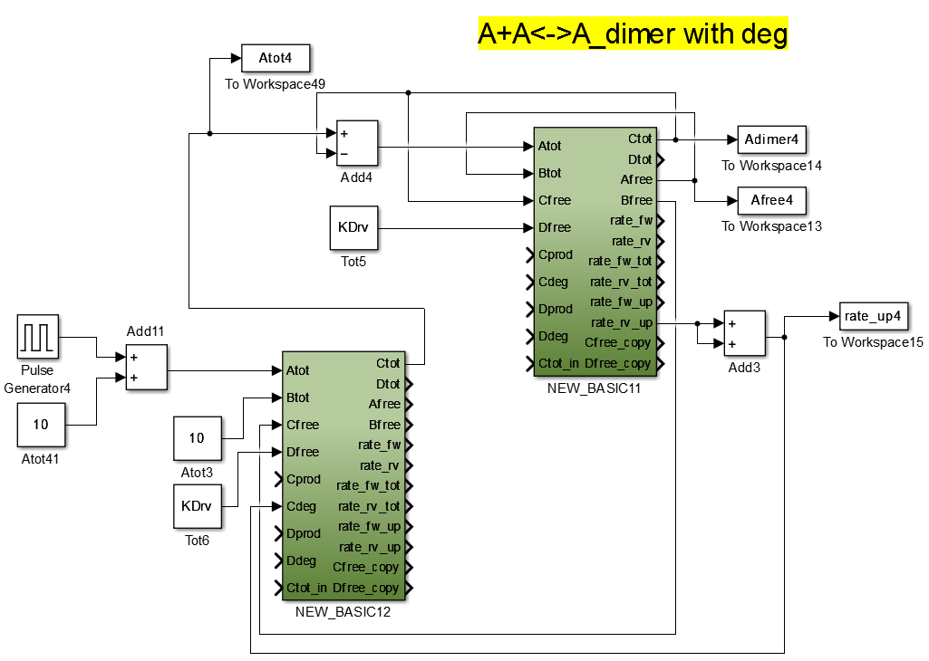
Dimerization

Slide 19
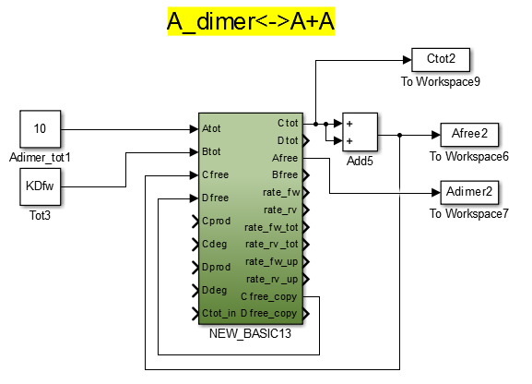
Monomerization

Slide 20
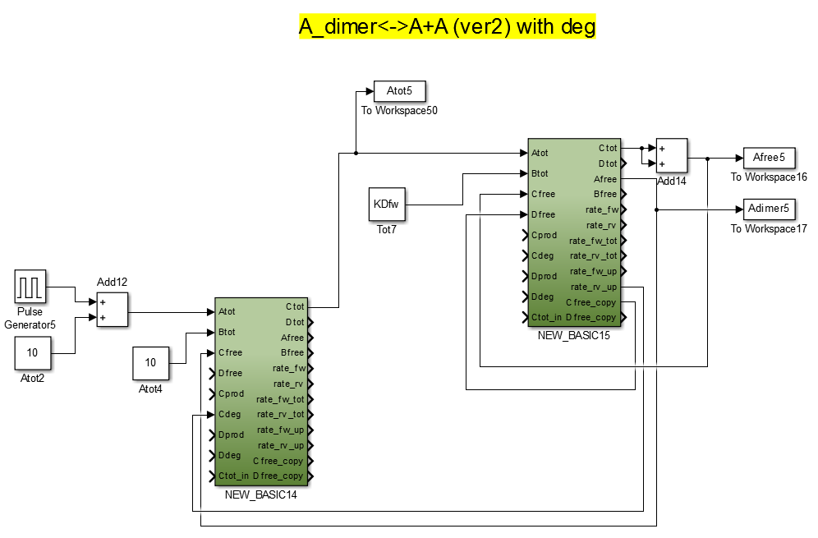
Monomerization

Slide 21
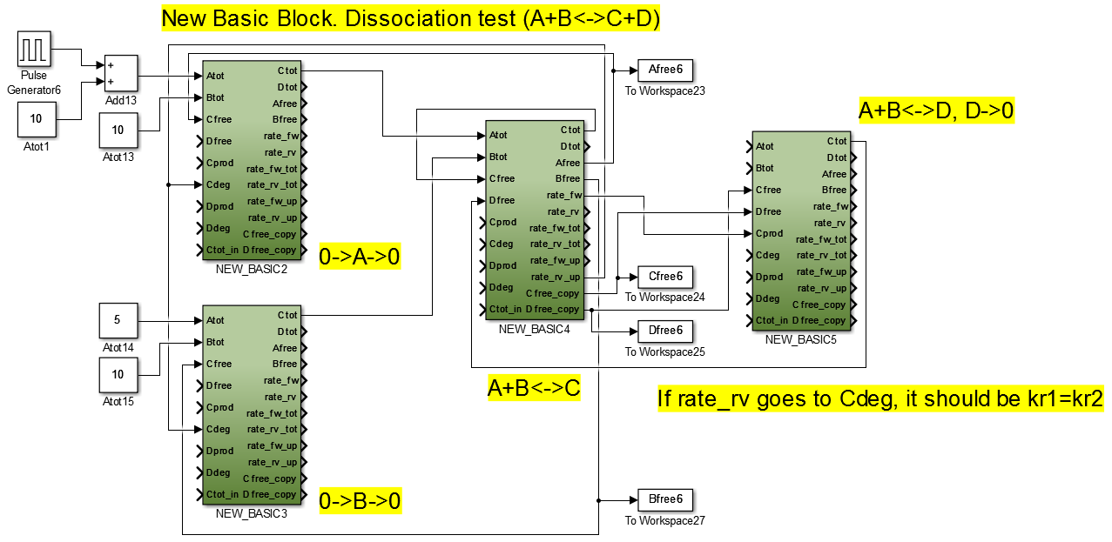
Dissociation

Slide 22
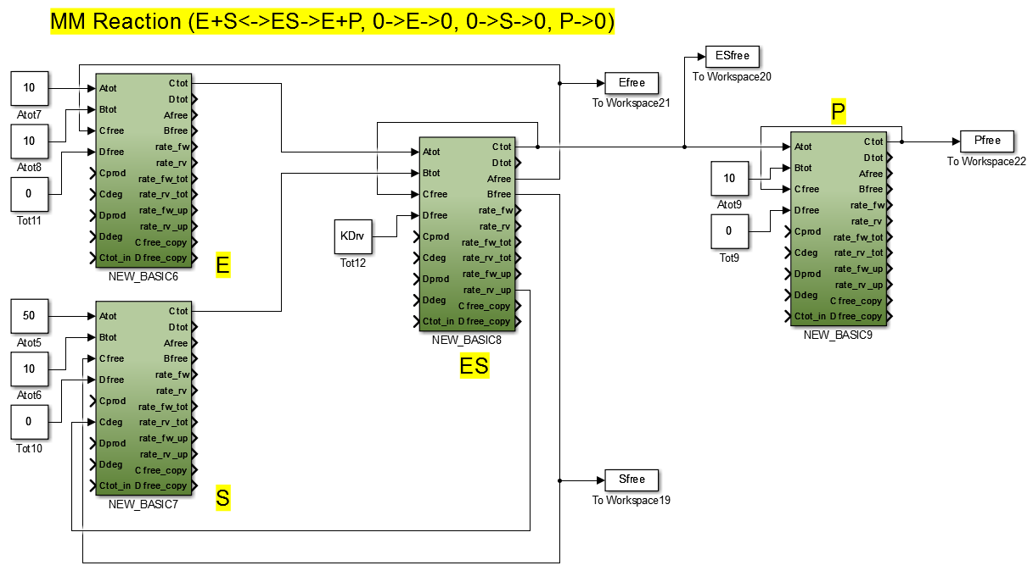
MM Reaction

Slide 23
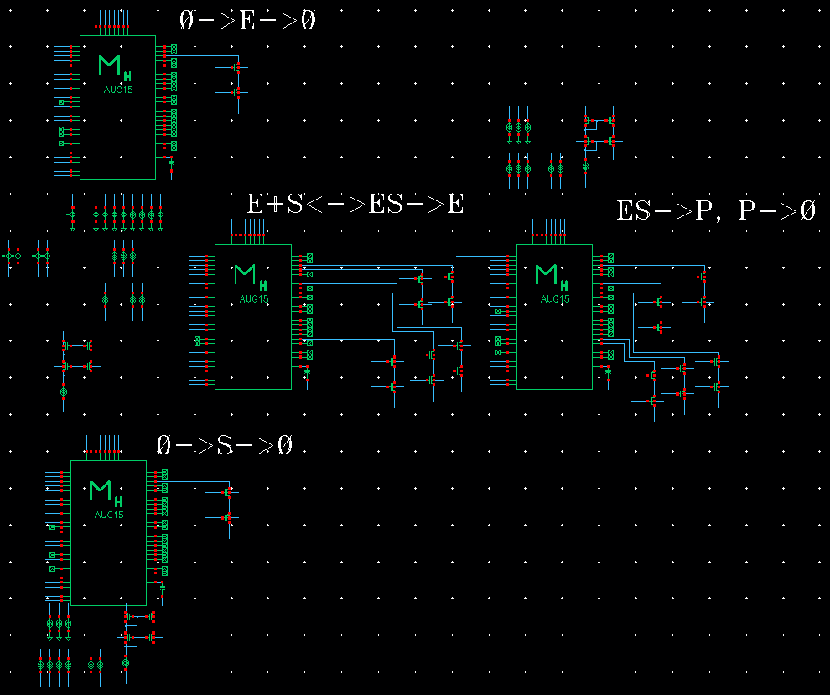
MM Reaction

Slide 24
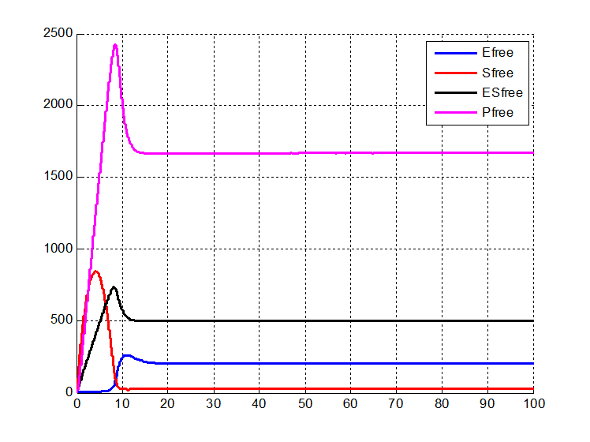
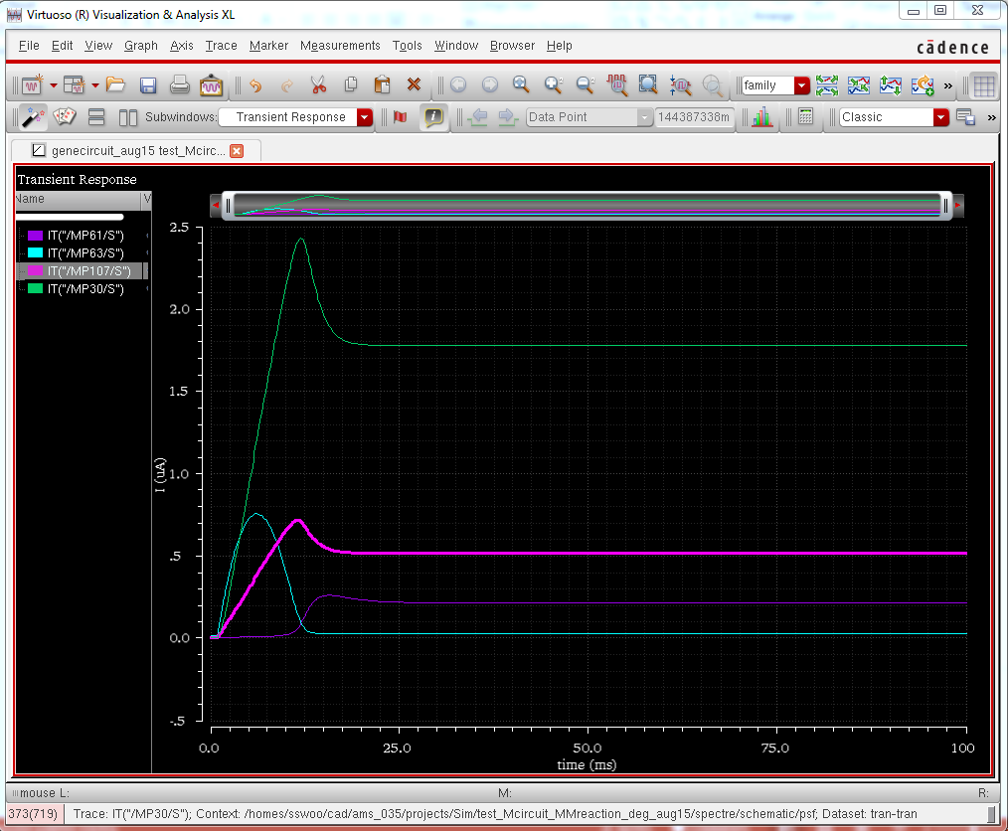
MM Reaction

Slide 25
Fan-in Reaction
One integrator, add/subtract other branches’ rates (all upstream total vars)

Slide 26
Fan-in Reaction
Algorithm
1) Combine all forward/reverse rates in one integrator (main branch)
2) Compute TOTAL forward/reverse rates, Ctot
3) Send TOTAL rates to another branch
4) In each branch, subtract current branch’s rates
5) Make two copies and send to upstream (Atot, Btot, Etot, Ftot)
6) In each upstream blocks, receive, add, give integrator, send upstream
7) Ctot – send to another branch to compute free (Efree, Ffree) and then forward rate (Efree*Ffree/KD)
8) Cfree – receive in main branch, send to another branch to compute reverse rate (Cfree*Gfree/KD)
Single kr for all integrators. Use multipliers to set ratio, which already exist
Shared wires for reverse rates and degradation.
Scalable algorithm: In each stage, receive from downstream, process, send to upstream

Slide 27
Sample Network

Slide 28
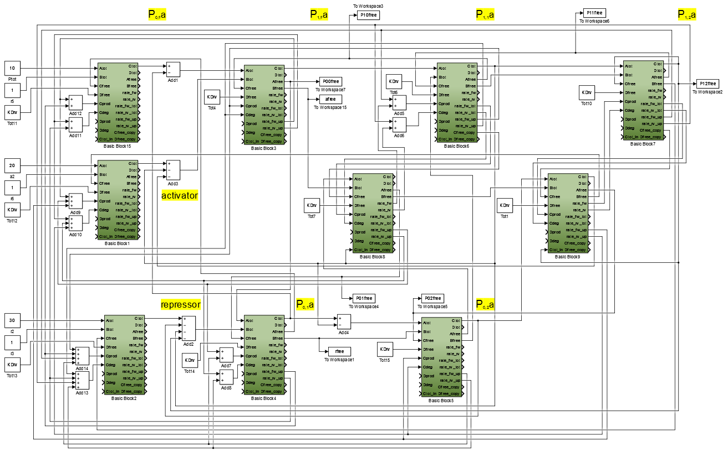

Slide 29
Simulink Model

Slide 30
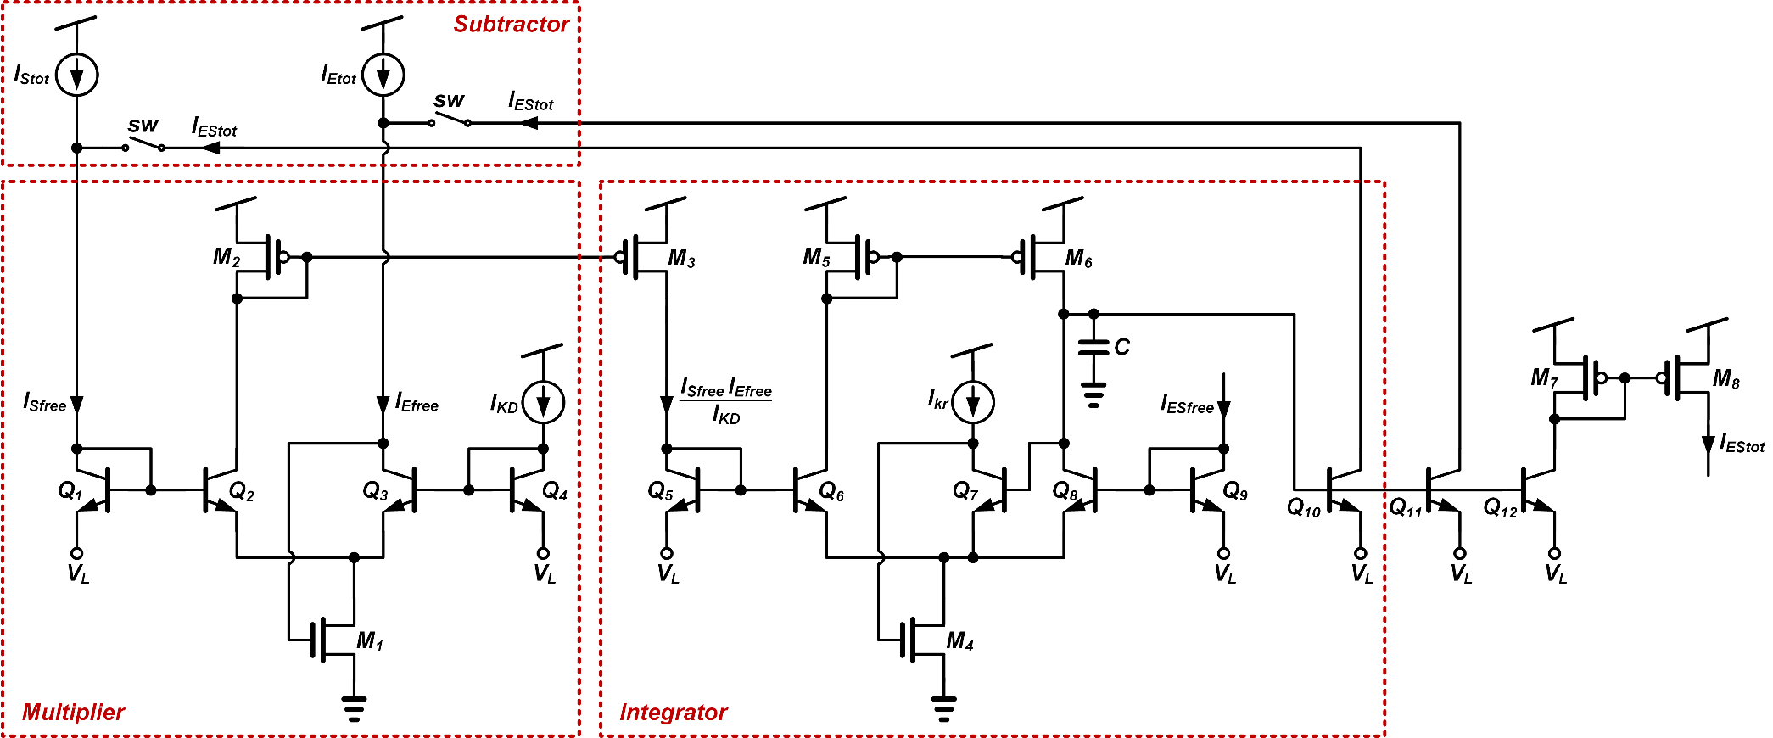

Slide 31
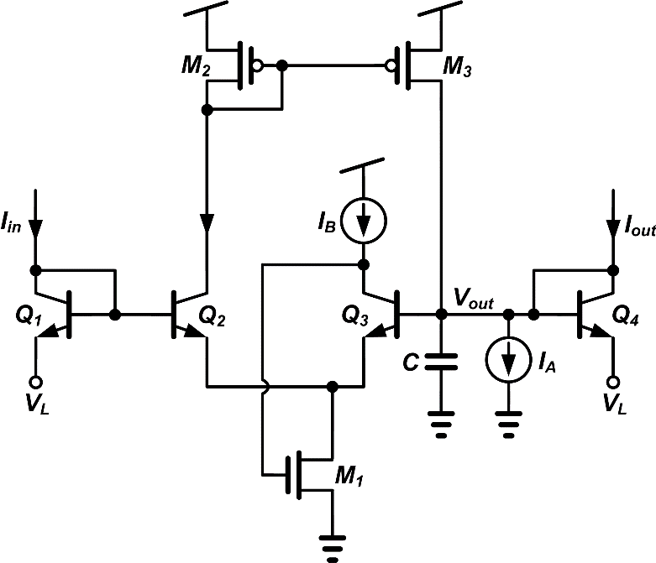
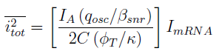
Noise Circuit

Slide 32
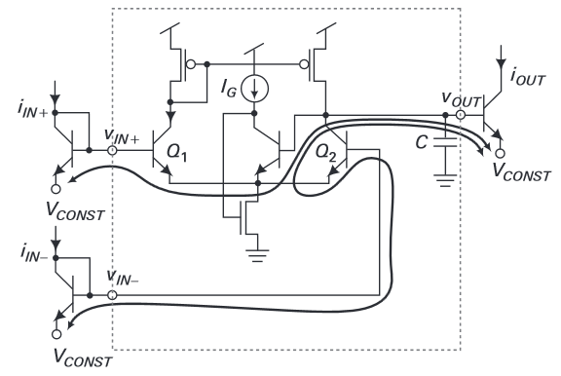
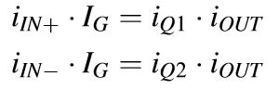
Noise Circuit

Slide 34
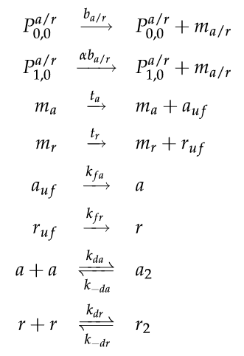
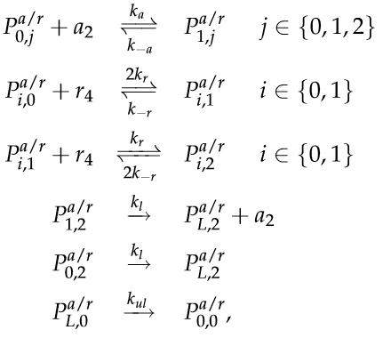
Verification

Slide 35
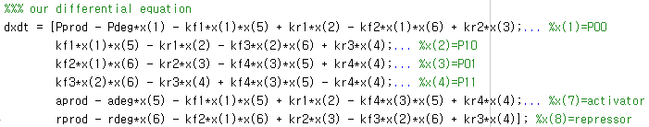
Simulink / Diff Eq Model

Slide 36
Simulink vs. Diff Eq Model

